Slide 1
Group #1 INTERFACING THINGSPEAK WITH BEAGLEBONE BLACK USING ESP8266
Submitted to – Prof. Mike Aleshams
Submitted by- Ramneet Kaur (C0752942)

Slide 2
List Of Contents
Introduction
Hardware and software Requirements
Purpose of using ThingSpeak in the project
Introduction to thingspeak
Writing Data to Cloud
HTTP v/s MQTT
Programming ESP8266
Main Code Integration
Results
References

Slide 3
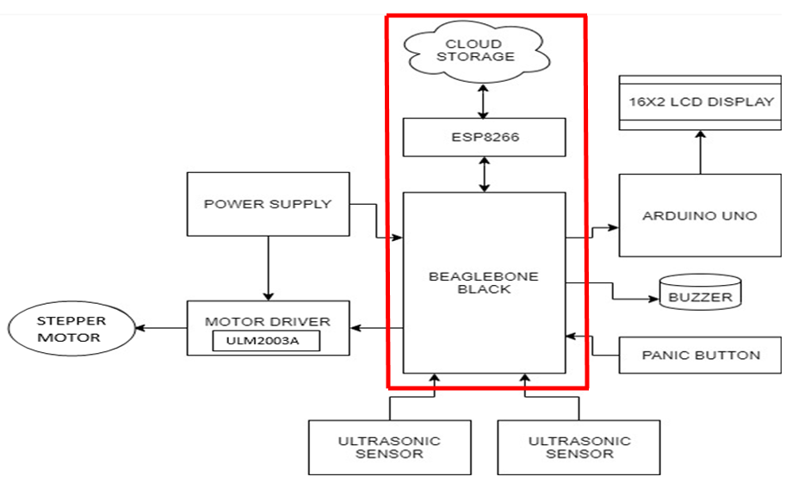
Iot Based Automatic Railway Gate Controller

Slide 4
Hardware And Software Requirements
Hardware Requirements
Node MCU ESP8266
Beaglebone Black
USB Wire
Connecting Wires
Breadboard
Software Requirements
Debian OS
Linux Operating System
Nano Editor
GCC compiler to run code
Arduino IDE for writing code for ESP 8266

Slide 5
Purpose of ThingSpeak in the Project
Our system is IOT enabled system we need to send data cloud service for tracking purposes.
As Beaglebone Black does not have inbuilt Wi-Fi module, so external Wi-Fi module i.e. ESP8266 module is connected for IoT connectivity.
Internet of Things (IoT) is a concept that aims to expand the benefits of connected internet connectivity continuously -the ability to share data, remote control, and etc, as well as on objects in the real world.
For example, food, electronics, collectibles, any equipment, including living things that are all connected to local and global networks through embedded and active sensors.
Notes:
In our project we need to send messages about gate status over the internet

Slide 6
THINGSPEAK!!
ThingSpeak is an IoT analytics platform service that allows you to aggregate, visualize, and analyze live data streams in the cloud.
Data can be sent to ThingSpeak from our devices and create instant visualizations of live data.
ThingSpeak enables engineers and scientists to prototype and build IoT systems without setting up servers or developing web software.

Slide 7
System Requirements
1. Devices:
Sensor data can be sent to ThingSpeak from Arduino, Raspberry Pi, BeagleBone Black, and other hardware.
For devices to communicate with ThingSpeak, they must support TCP/IP, HTTP or MQTT protocols.
2. Website:
ThingSpeak is compatible with most modern web browsers running on Windows, Mac, or Linux operating systems as well as Chromebooks.
For browsers (like Chrome and Firefox) that update automatically, the current stable version is supported.

Slide 8
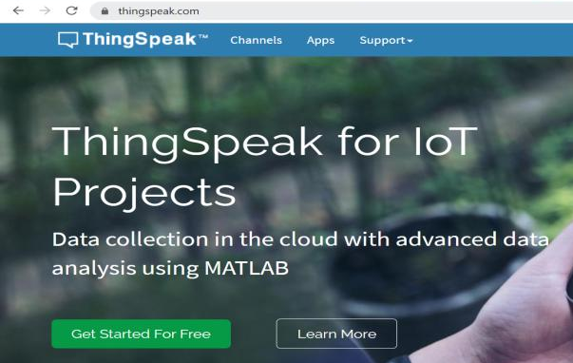
Getting Started with ThingSpeak
Steps:
Go to: https://thingspeak.com
Click on:
Create an account using email id and password.
Make a new Channel.
Get Started For Free

Slide 9
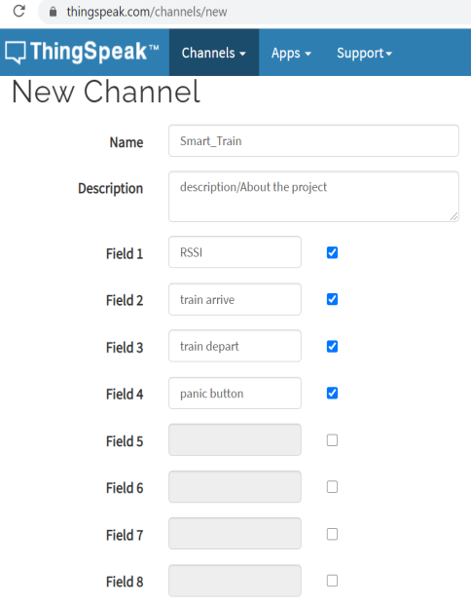
Creating a New Channel
Channel Settings:
Percentage Complete: Calculated based on data entered into the various fields of a channel.
Channel Name: Enter a unique name for the ThingSpeak channel.
Description: Enter a description of the ThingSpeak channel.
Field #: Check the box to enable the field, and enter a field name. Each ThingSpeak channel can have up to 8 fields.

Slide 10
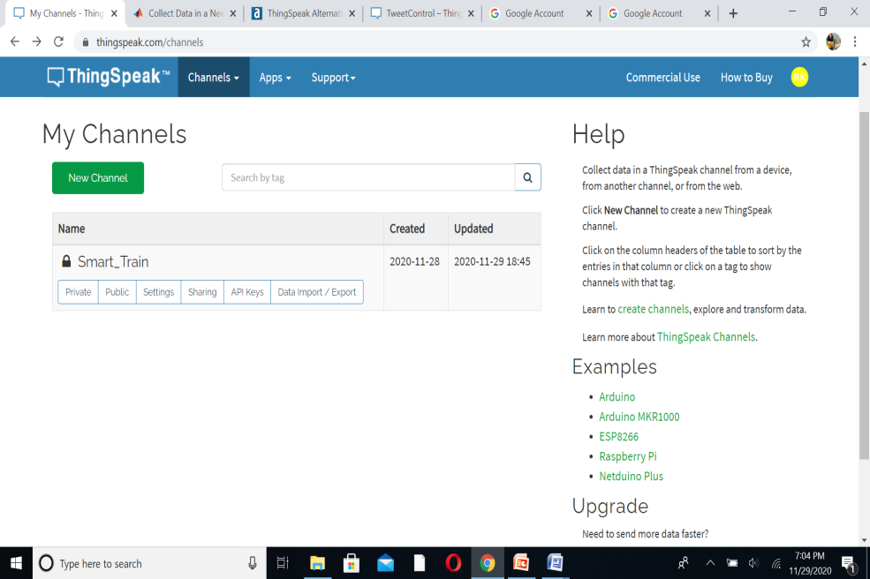
Home Page

Slide 11
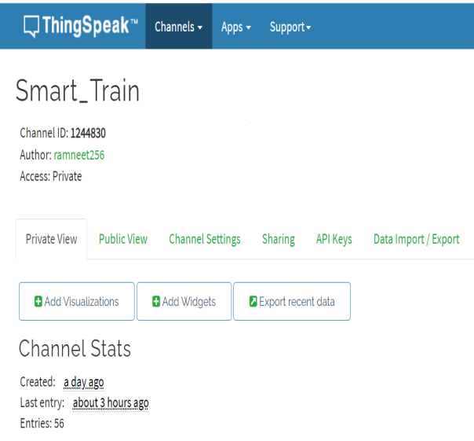
Channel Details
Channel ID: 1244830
Access: Private
Private View-
Date of Channel Created
Last Entry
Total Entries
Adding Visuals, Widgets, Export Data
Field Charts- Title, Axis, Color, Type of Chart, Days and Results

Slide 12
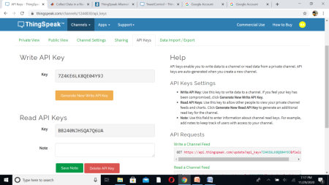
API Keys
An application programming interface key is a unique identifier used to authenticate a user, developer or project(typically)
API keys enable you to write data to a channel or read data from a private channel.
API keys are auto-generated when you create a new channel.
API Keys Settings-
Write API Key: Use this key to write data to a channel. If you feel your key has been compromised, click Generate New Write API Key.
Read API Keys: Use this key to allow other people to view your private channel feeds and charts. Click Generate New Read API Key to generate an additional read key for the channel.

Slide 13
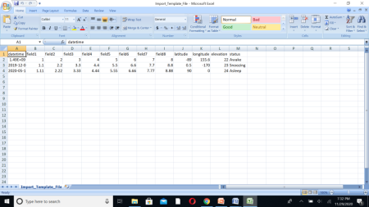
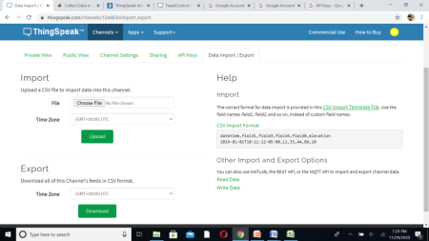
Data Import/Export
Import:
The correct format for data import is shown below:
Use the field names field1, field2, and so on, instead of custom field names.

Slide 14
Write Data to Channel
ThingSpeak is an IoT platform that uses channels to store data sent from apps or devices.
Data can be written to your ThingSpeak channels in several ways:
HTTP calls from the REST API,
MQTT Publish method,
thingSpeakWrite function from MATLAB

Slide 15
HTTP calls from the REST API
Representational state transfer (REST) is an architectural style designed as a request-response model that communicates over HTTP.
ThingSpeak, an IoT platform, uses the REST API calls GET, POST, PUT, and DELETE to create and delete channels, read and write channel data, and clear the data in a channel.
A web browser or client sends a request to the server, which responds with data in the requested format.
Example:
Read Data
Read data from all fields in a channel with HTTP GET
HTTP Method: GET
URL https://api.thingspeak.com/channels/<channel_id>/feeds.<format>
Example: https://api.thingspeak.com/channels/266256/feeds.json
Write Data
Write data from all fields in a channel with HTTP POST or PUT
HTTP Method: POST or PUT
URL
https://api.thingspeak.com/update.<format> Example:https://api.thingspeak.com/update.json

Slide 16
MQTT Protocol
MQTT stands for Message Queue Telemetry Transport is a lightweight messaging protocol designed for Machine to machine telemetry in resource constrained environments like embedded systems.
It is developed primarily to connect bandwidth and power-constrained devices over wireless networks.
MQTT is Publish/Subscribe based model i.e. it is event driven and enabled messages to be pushed to clients.
The publish/subscribe architecture enables messages to be pushed to the client devices without the device needing to continuously poll the server.
The important parts of MQTT protocol are:
MQTT Broker: MQTT broker is the central point of communication,
MQTT Client: A client is any device that connects to the broker
Topic: A topic contains the routing information for the broker.

Slide 17
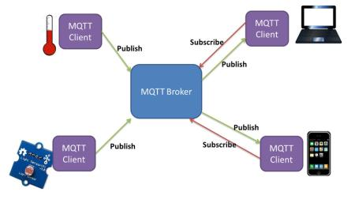
Basic Concepts of MQTT
The MQTT broker is the in charge of dispatching all messages between the senders and the rightful receivers(clients).
A client can publish or subscribe to topics to access the information.
Each client that wants to send messages publishes them to a certain topic, and each client that wants to receive messages subscribes to a certain topic.
The broker delivers all messages with the matching topic to the appropriate clients.
ThingSpeak has an MQTT broker at the URL mqtt.thingspeak.com and port 1883.

Slide 18
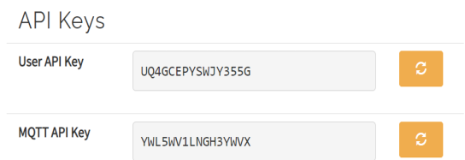
MQTT Publish/Subscribe method
MQTT Publish:
To publish to a channel feed means to write to the channel.
The Write API Key is required to publish.
MQTT Subscribe
To subscribe to a public or private channel, we must also supply a user name and MQTT API key as password when connected.
MQTT API Key
To see your MQTT API key, choose Account > My Profile.

Slide 19
HTTP v/s MQTT
HTPP is document centric.
HTTP is request-response protocol for client-server.
Computing and not always optimized for mobile devices.
Allows to compose lengthy headers and messages.
Slower than MQTT as as HTTP specifications are much longer.
MQTT is data centric
It is Publish-Subscribe protocol.
MQTT in these terms are lightweightness.
Very short message header (smallest packet message size of 2 bytes).
According to measurements in 3G networks, throughput of MQTT is 93 times faster than HTTP’s.
CONCLUSION:
MQTT Protocol is easy of use. It is essential when response time, throughput, lower battery and bandwidth usage are on the first place for future solutions.
HTTP is worthy and extendable. But MQTT is more suitable when it is referred
to IoT development.

Slide 20
Using ESP8266
The ESP8266 is a System on a Chip (SoC).
It consists of a Tensilica L106 32-bit MCUand a Wi-Fi transceiver.
It has 11 GPIO pins and an analog input as well.
This means that it can be programmed like any normal Arduino or MCU. And on top of that, it provides Wi-Fi communication, so it can be used it to connect to internet.
Adding ESP8266 to our project extends the capability of our system to connect with cloud services wirelessly and enables IOT based functionalities.

Slide 21
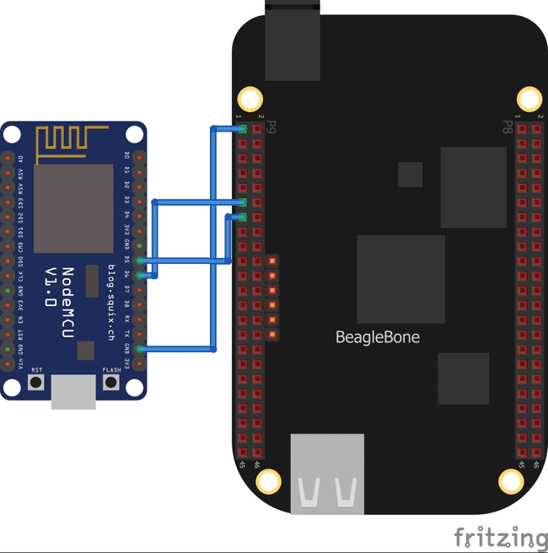
UART interfacing between Beaglebone Black and ESP8266
BBB has 4 UARTs, named as BB-UART1, BB-UART2, BB-UART4, BB-UART5.
We have used BB-UART4 for interfacing with ESP8266 serially.
The ESP 8266 is powered through micro-USB cable.
BEAGLEBONE BLACK | ESP8266
P9.11 (UART4_RXD) | D6 (GPIO 12- TX)
P9.13 (UART4_TXD) | D5 (GPIO 14- RX)
P9.1 (GND) | GND (GPIO 2)

Slide 22
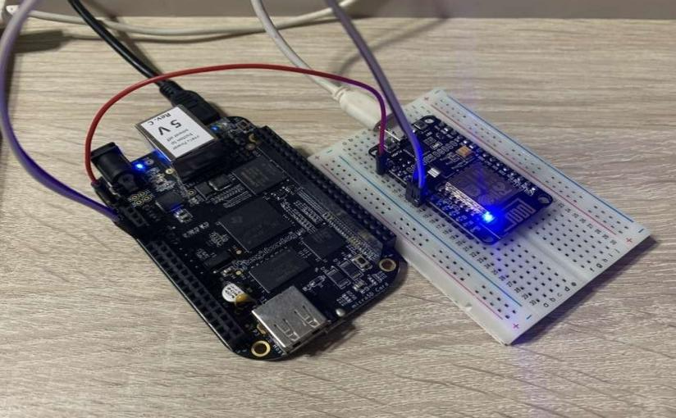
Connection Diagram: BBB with ESP8266

Slide 23
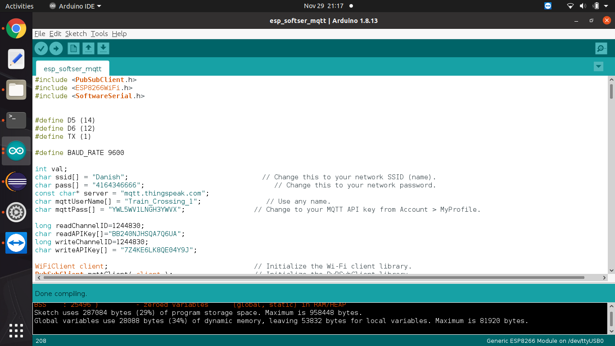
Programming ESP8266 Arduino IDE will be used writing the code and flashing the code to ESP module
Headerfiles Used:
PubSubClient.h- allows to send and receive MQTT messages.
ESP8266WiFi.h- provides ESP8266 specific Wi-Fi routines that we are calling to connect to the network.
SoftwareSerial.h- allow serial communication on other digital pins
Variables Declaration:
ID and pass for Wifi
MQTT server, user name and pass
Channel ID and Write/Read APIs

Slide 24
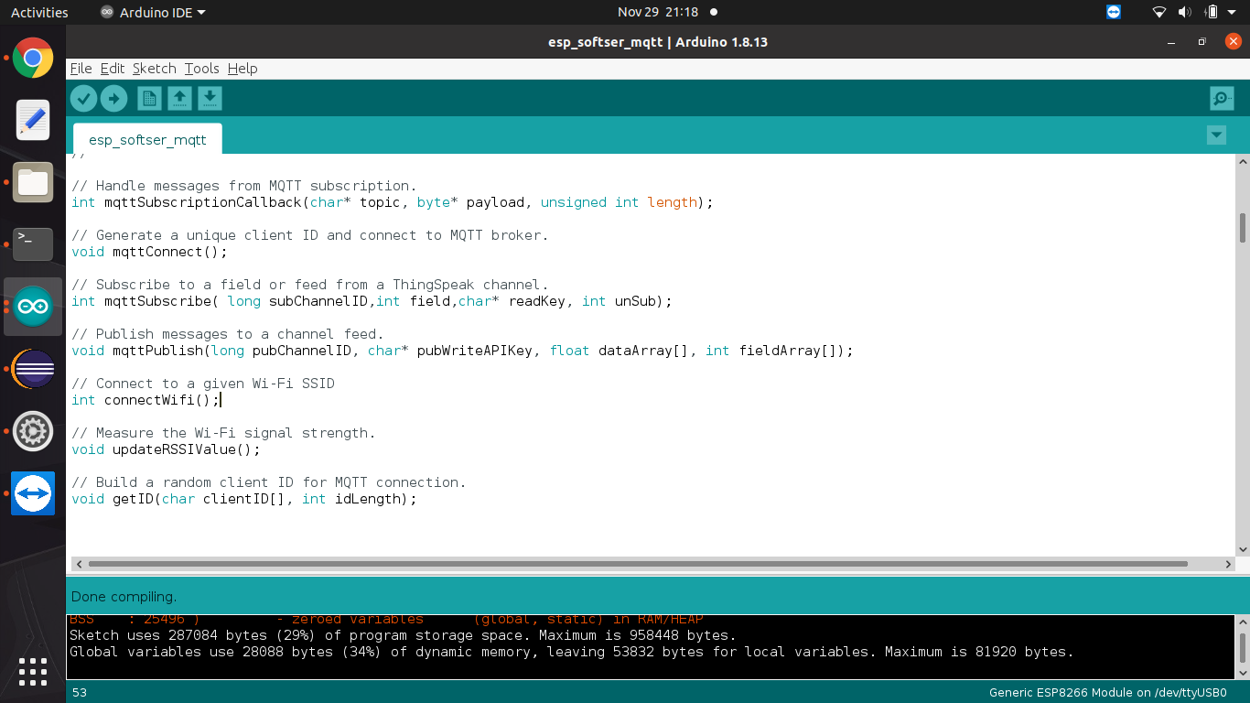
Continue…
Functions Used:

Slide 25
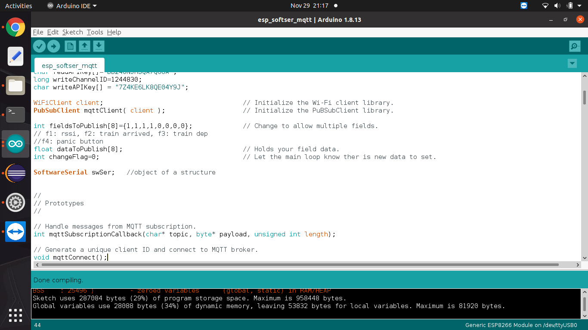
Continue…
Initialize the PuBSubClient library.
Initialize the Wi-fi Client library.
Initialize fields in Channel- total are 8
Field 1: RSSI,
Field 2: Train Arrived,
Field 3: Train Departed
Field 4: Panic Button Status

Slide 26
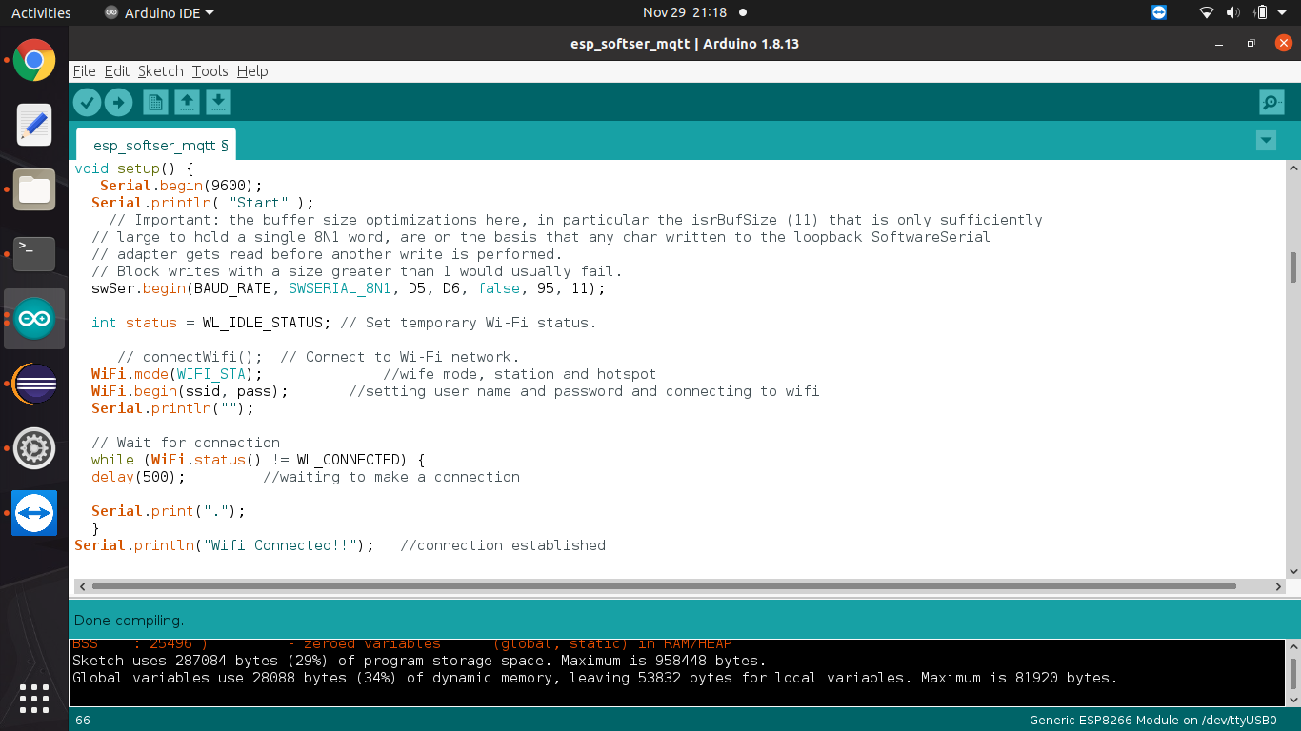
Continue…
Void Setup(): One-time operations.
Set Baud Rate – 9600
Initializing serialSoftware function to read the data from BBB
Setting WiFi mode and connecting to given network ID and Password.
Reading the status of WiFi.
Printing the status of WiFi.

Slide 27
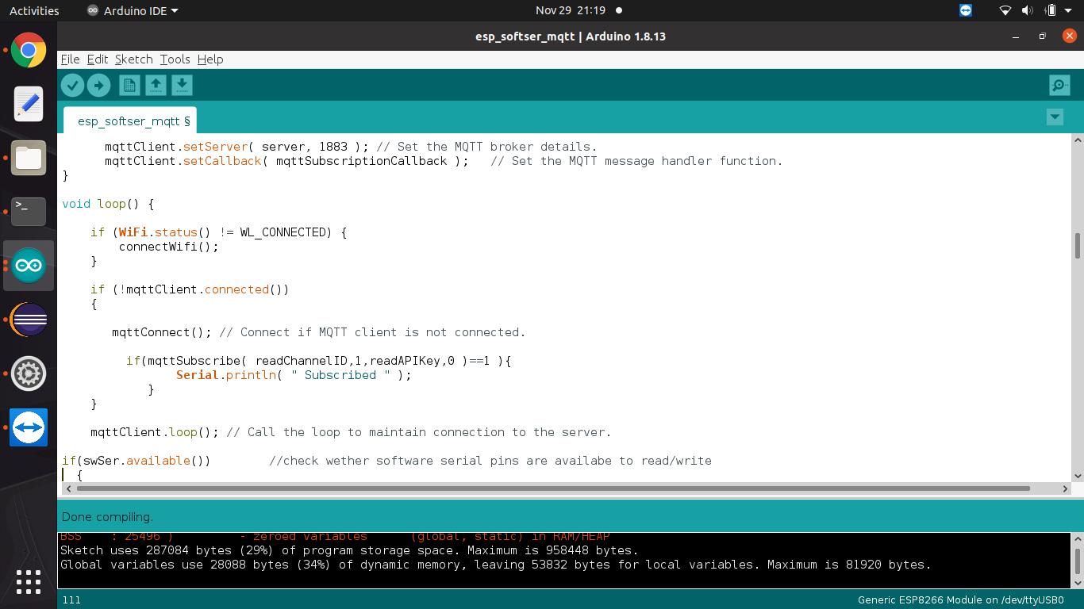
Continue…
Once the wifi has been successfully connected, call the functions to:
Set the MQTT broker details:
mqttClient.setServer( server, 1883 );
Set the MQTT message handler function.
mqttClient.setCallback( mqttSubscriptionCallback );
Void loop(): Task to be done repeatedly.
Connect to wifi, if not connected.
Connect if mqttClient is not connected.
Read the channel that are already been subscribed for updates.
Print Status.

Slide 28
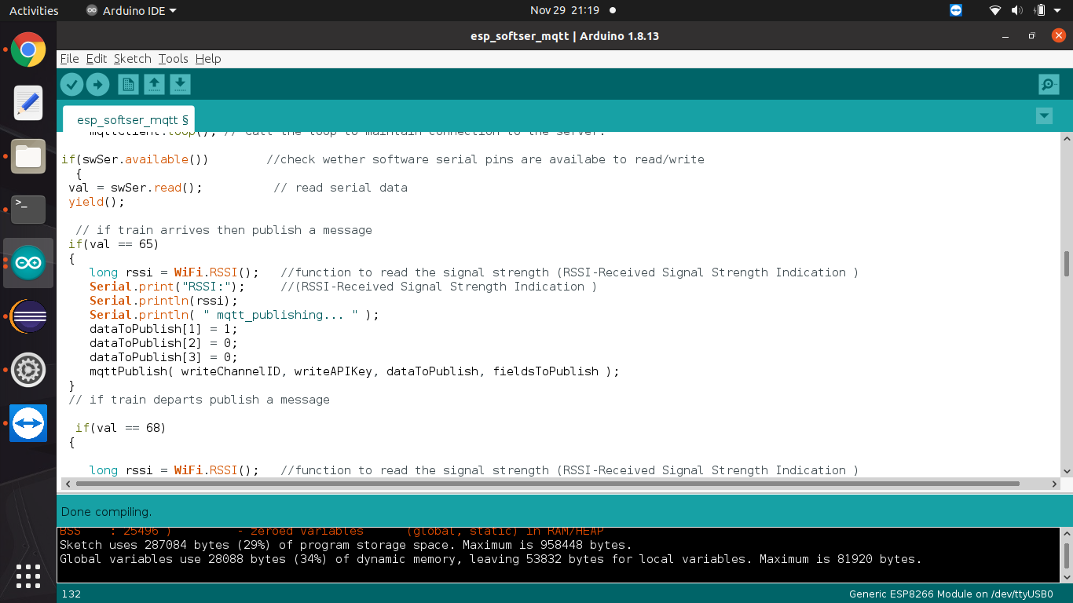
Continue…
Receive data from BBB and publish it to cloud using MQTT.
If “A” is received over UART1 of ESP:
Print the Signal strength to serial UART.
Print status of Mqtt
Also publish data to Cloud using Mqtt.
(In this case the Field 2 will be updated).
Similarly,
“A” - Field 2: Train Arrived,
“D” - Field 3: Train Departed
“p” - Field 4: Panic Button Status

Slide 29
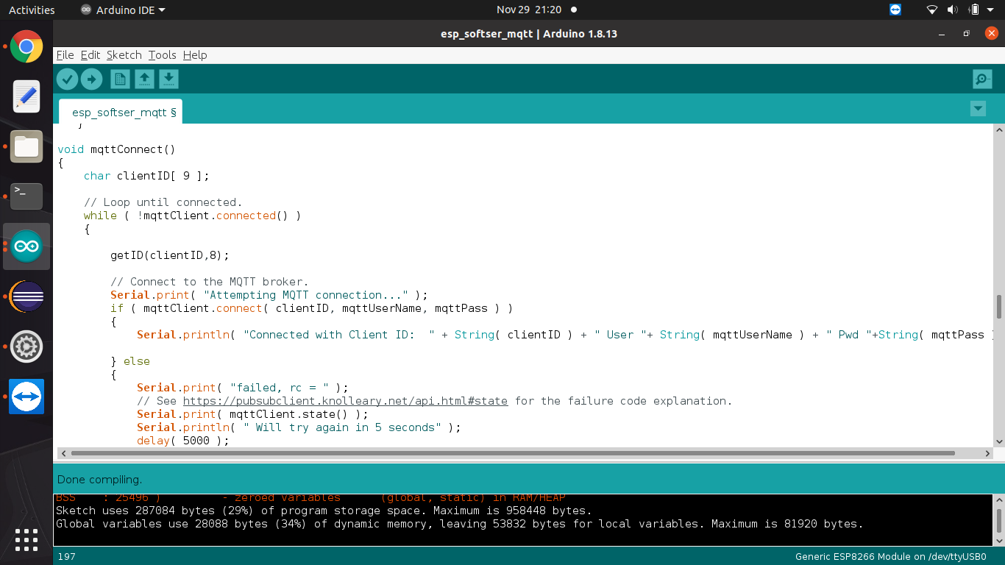
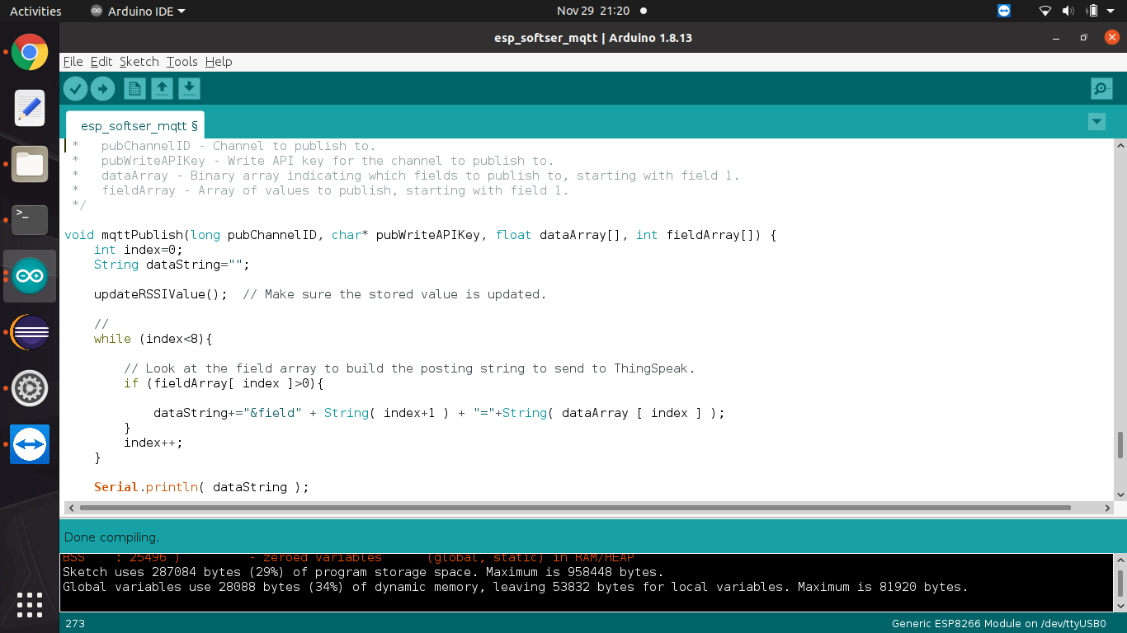
Continue…
mqttConnect():
mqttPublish():
mqttConnect():

Slide 30
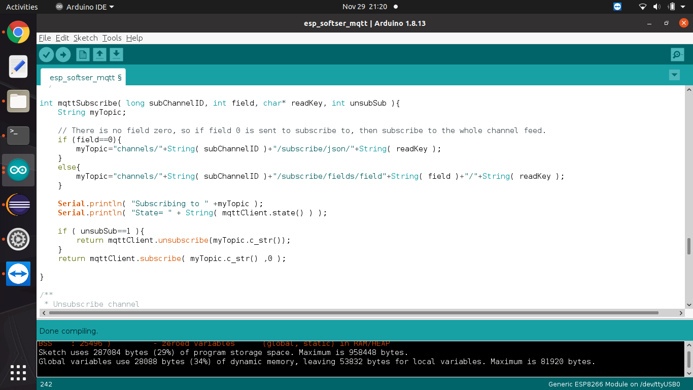
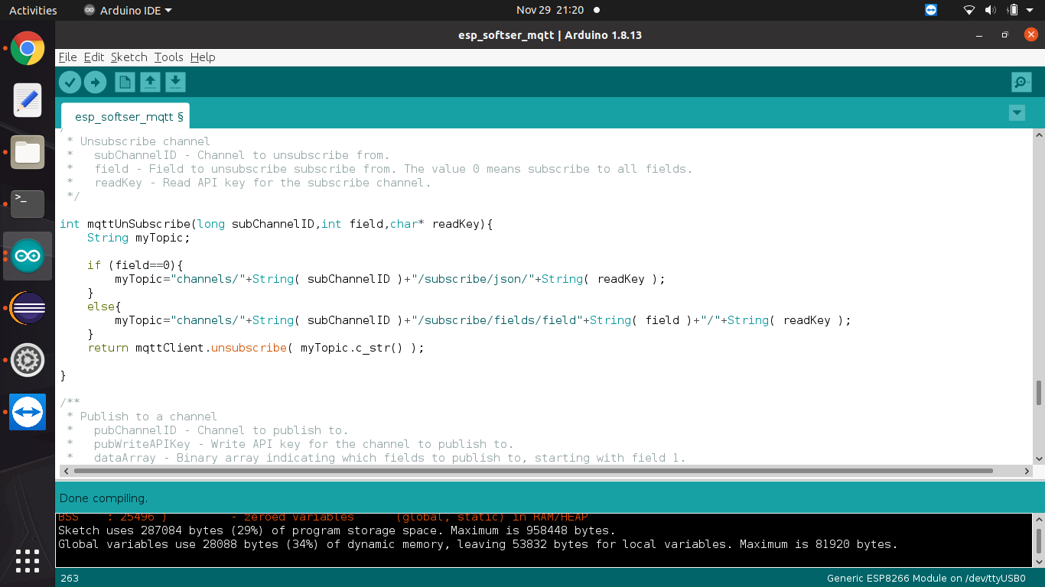
Continue…
mqttSubscribe():
mqttUnSubscribe():

Slide 31
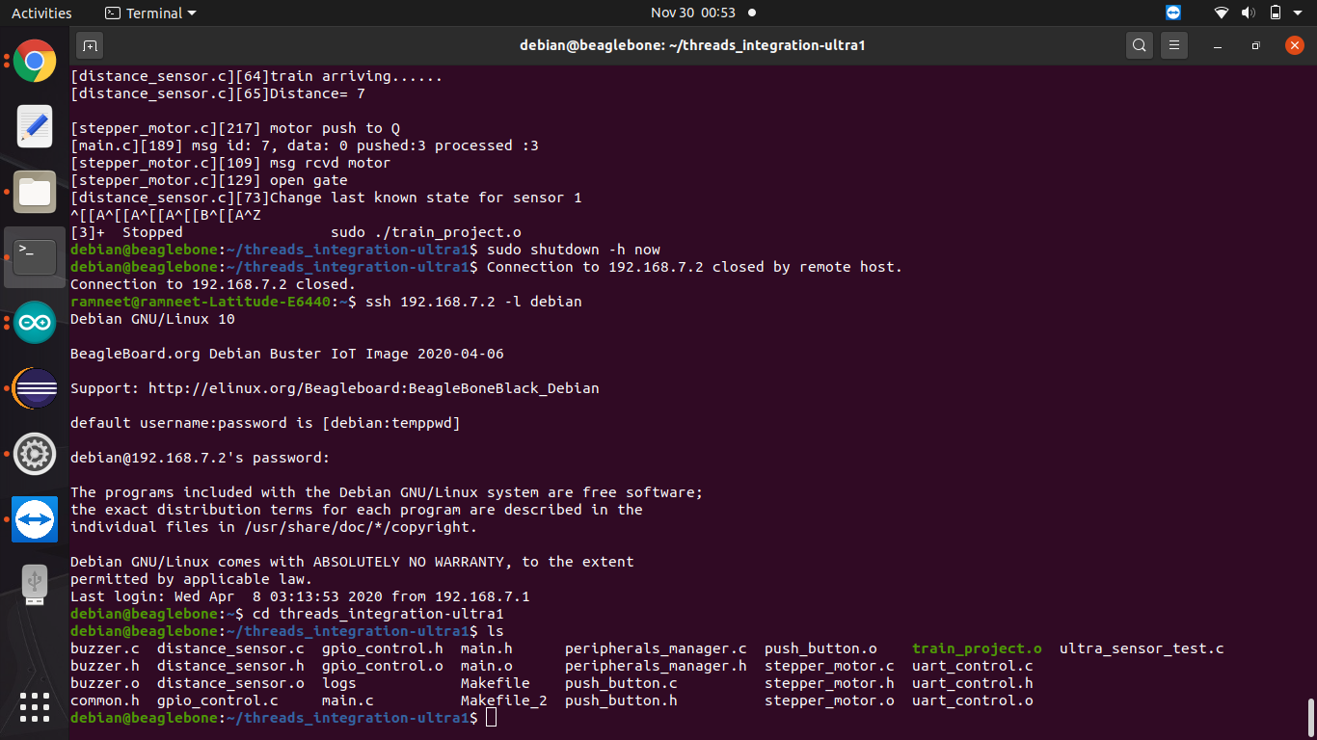
Integrated Project Code
We have integrated all the interfacing done till date and created a multi-threaded system to control different peripherals and functionalities.
Interfacing Panic Button and Buzzer with BBB
Interfacing Ultrasonic Sensors with BeagleBone Black
Interfacing stepper motor with BeagleBone Black
Interfacing ESP 8266 with BBB
Interfacing ThingSpeak with ESP8266

Slide 32
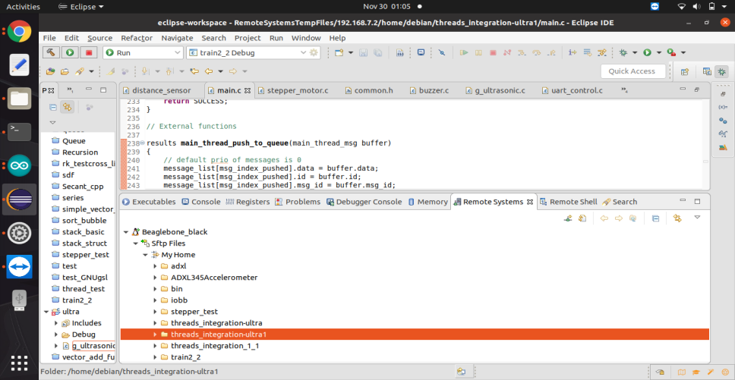
Eclipse IDE
Eclipse IDE was used to create the project and files were sent to BBB using Remote System sessions.

Slide 33
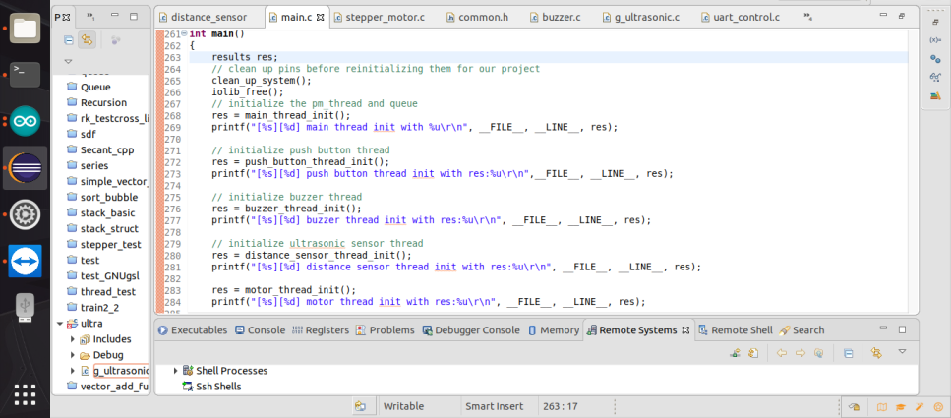
Main Function
In this function we are initializing all the threads and queues.
For each interfacing, we have created individual tasks and are all initialized in main function.

Slide 34
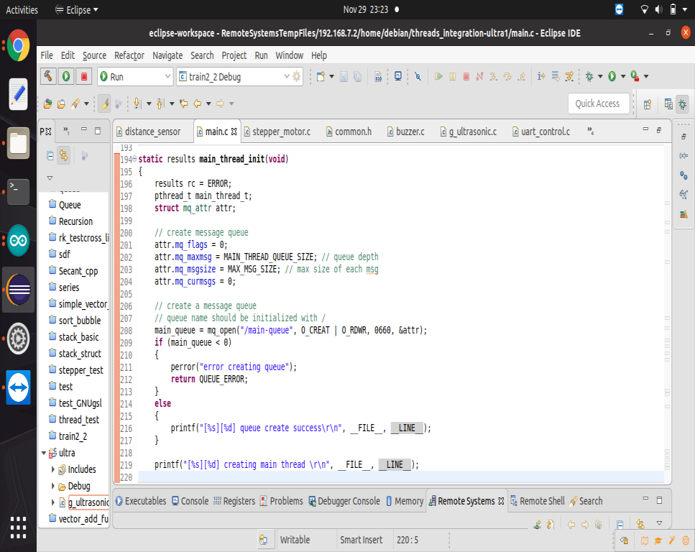
Main_thread_init()
This function initializes the main thread and create a queue of main thread.
This thread will act as a mediator and helps synchronizing different threads.
Example: If train arrives, distance sensor thread will add a message to main thread’s queue and then
Main thread will turn On the buzzer
Send a message to ESP
Rotate the Stepper Motor
Display a Message to LCD (to be implemented…)

Slide 35
Queue create function
The mq_open() function shall establish the connection between a process and a message queue with a message queue descriptor.
It shall create an open message queue description that refers to the message queue, and a message queue descriptor that refers to that open message queue description.
The message queue descriptor is used by other functions to refer to that message queue

Slide 36
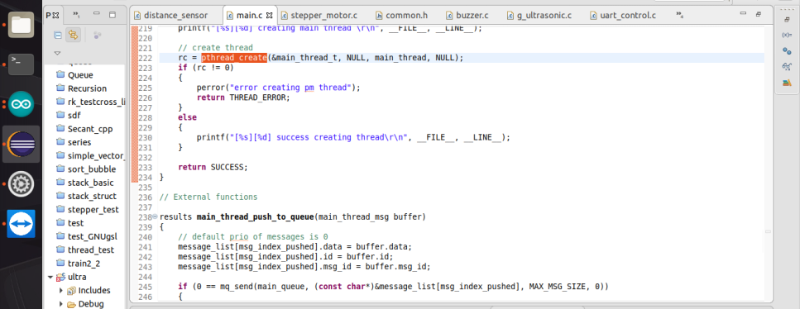
Thread Create Function
The pthread_create() function is used to create a new thread, with attributes specified by attr, within a process.
If attr is NULL, the default attributes are used.
If the attributes specified by attr are modified later, the thread's attributes are not affected.
Upon successful completion, pthread_create() stores the ID of the created thread in the location referenced by thread.

Slide 37
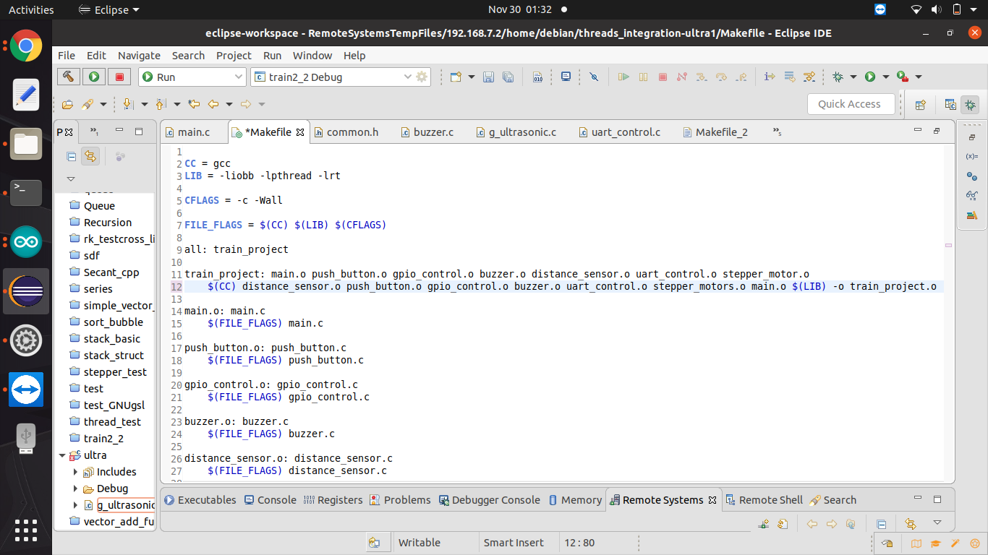
Compile and Run
To run and compile the code we can create a Makefile or this can also be auto generated by eclipse.

Slide 38
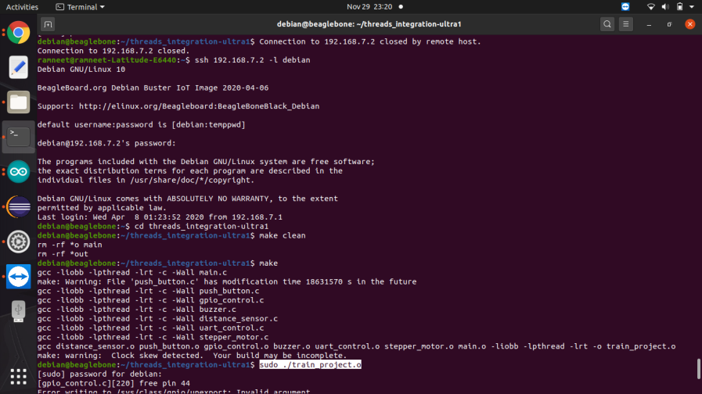
Continue…

Slide 39
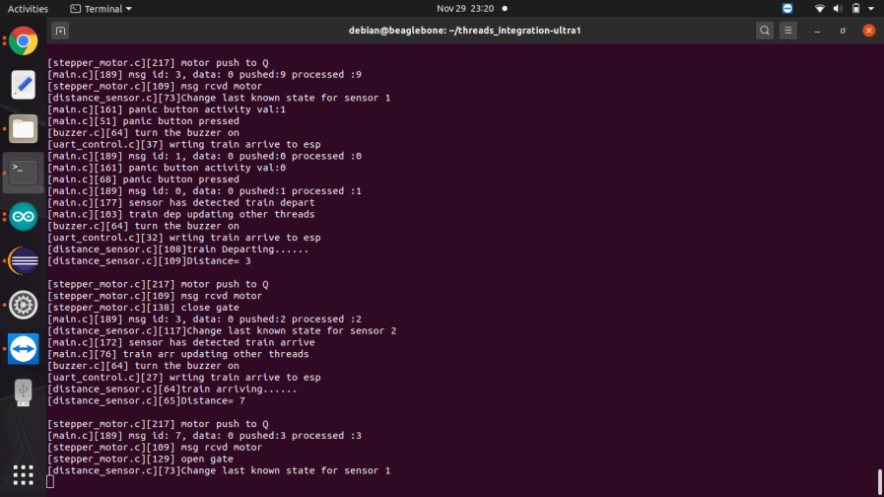
Results

Slide 40
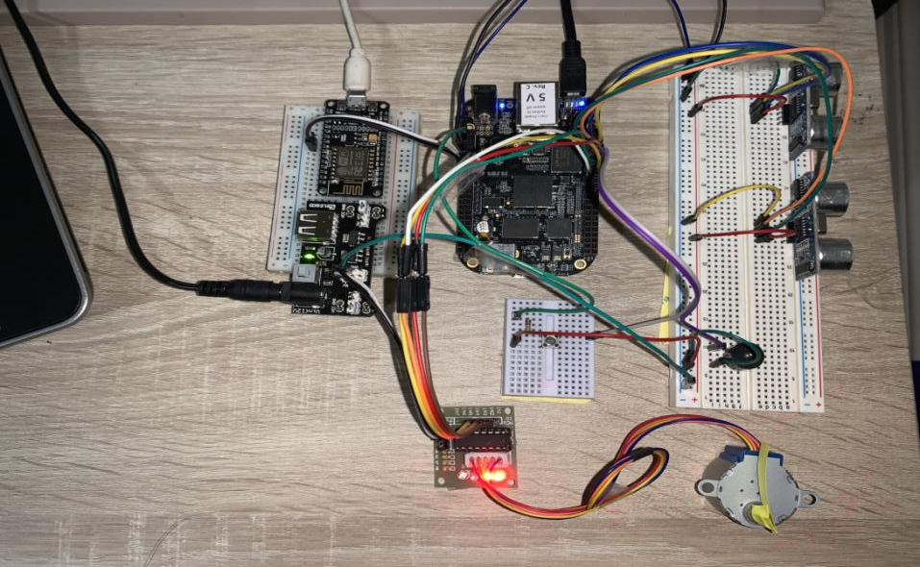
Hardware Connections

Slide 41
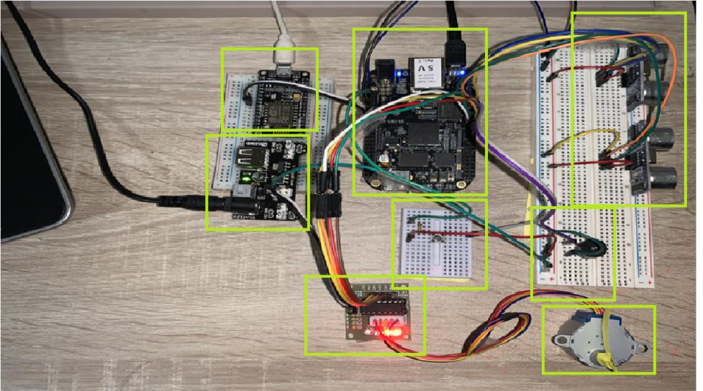
Continue…
Sensor 1
BBB
ESP8266
Power Supply
Sensor 2
Switch
Buzzer
ULN2003A
Motor

Slide 42
References
Serial ports / UART. (n.d.). Retrieved from Cameon Beaglebone: https://sites.google.com/a/cameon.net/beaglebone/home/serial-ports-uart
NodeMCU ESP8266. (2020, April 22). Retrieved from Components 101: https://components101.com/development-boards/nodemcu-esp8266-pinout-features-and-datasheet
NodeMCU ESP8266. (2020, April 22). Retrieved from Component 101: https://components101.com/development-boards/nodemcu-esp8266-pinout-features-and-datasheet
Station Class. (n.d.). Retrieved from ESP8266 Arduino Core: https://arduino-esp8266.readthedocs.io/en/latest/esp8266wifi/station-class.html#:~:text=DE%3AC1%3A68-,RSSI,Signal%20Strength%20Indication%20(RSSI).&text=Signal%20strength%20value%20is%20provided,of%20returned%20value%20is%20int32_t%20.
Trev. (2018, February 9). How to get UART serial ports working on the beaglebone black. Retrieved from Trevor's electronics blog: https://electronics.trev.id.au/2018/02/09/get-uart-serial-ports-working-beaglebone-black/

Slide 43
Continue…
O'Leary, N. (2019, May). pubsubclient. Retrieved from Github.com: https://github.com/knolleary/pubsubclient/blob/master/src/PubSubClient.h
Rouse, M. (n.a). IOT Agenda. Retrieved from https://internetofthingsagenda.techtarget.com/definition/Internet-of-Things-IoT#:~:text=The%20internet%20of%20things%2C%20or,human%2Dto%2Dcomputer%20interaction.
Serozhenko, M. (2017, March 20). MQTT vs. HTTP: which one is the best for IoT? Retrieved from https://medium.com/mqtt-buddy/mqtt-vs-http-which-one-is-the-best-for-iot-c868169b3105#:~:text=MQTT%20is%20data%20centric%20whereas,always%20optimized%20for%20mobile%20devices.&text=Besides%2C%20publish%2Fsubscribe%20model%20provides,reliability%20of%20the
ThingSpeak for IOT projects. (n.a). Retrieved from ThingSpeak.com: https://thingspeak.com/
Component101. (2018, July 9). BeagleBone Black. Retrieved from https://components101.com/microcontrollers/beaglebone-black-pinout-datasheet

Slide 44

THANK YOU!!

